Slide 1
CUDA Optimization Techniques
Anfal AlYousufi
Department of Computer science and engineering
University of South Florida
July 16th 2018
aalyousufi@mail.usf.edu

Slide 2
Outline
Terms of optimization:
Optimizations for latency bound kernels
Optimization for compute bound kernels
Optimization for memory bound kernels

Slide 3
Optimizations for latency bound kernels

Slide 4
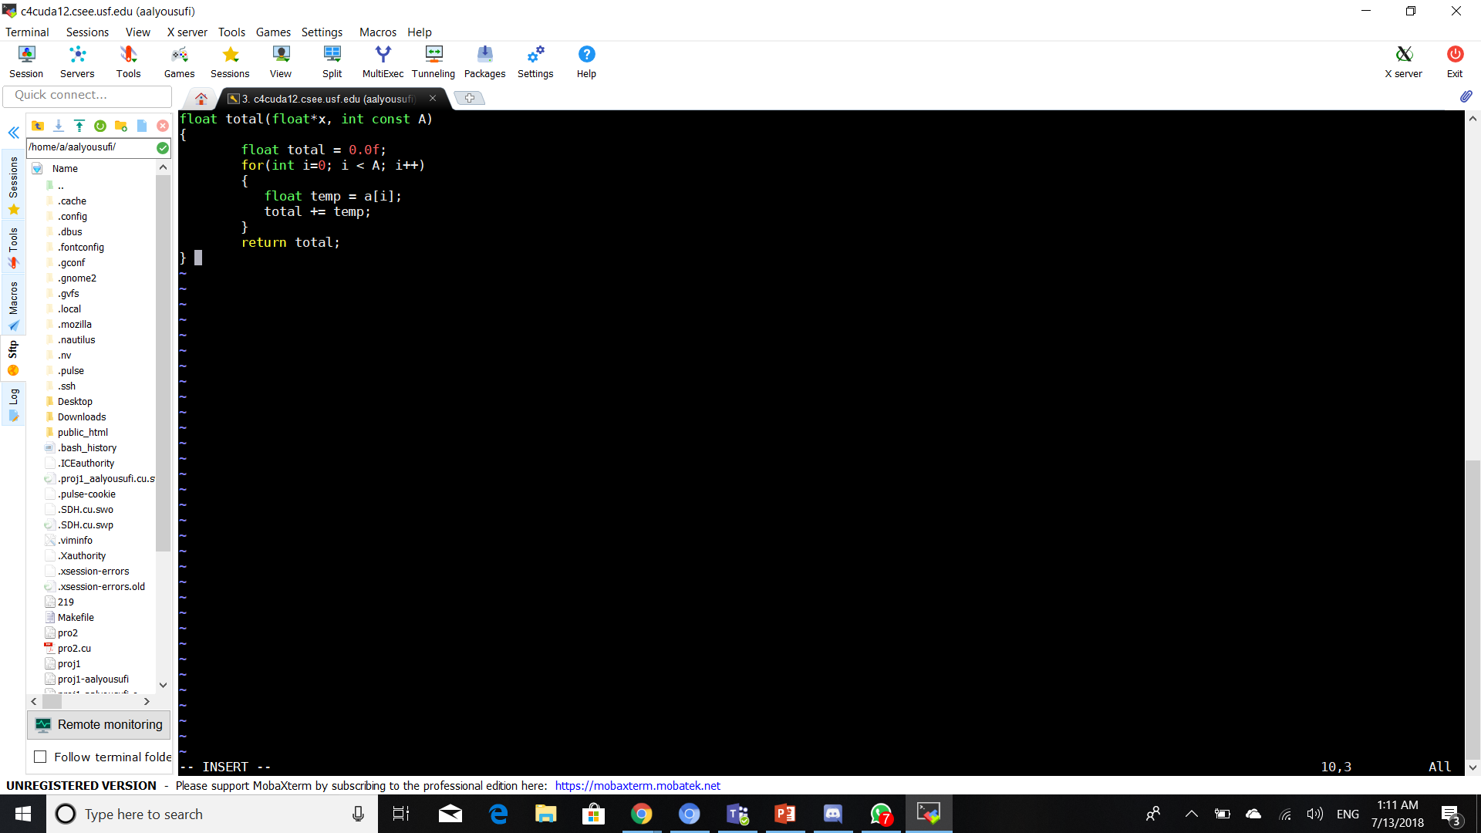
Optimizations for latency bound kernels
Processor stalls/idle: cannot execute the next instruction due to a dependency on the previous instruction.
Stall waiting on a[i] from memory
Time(clocks)

Slide 5
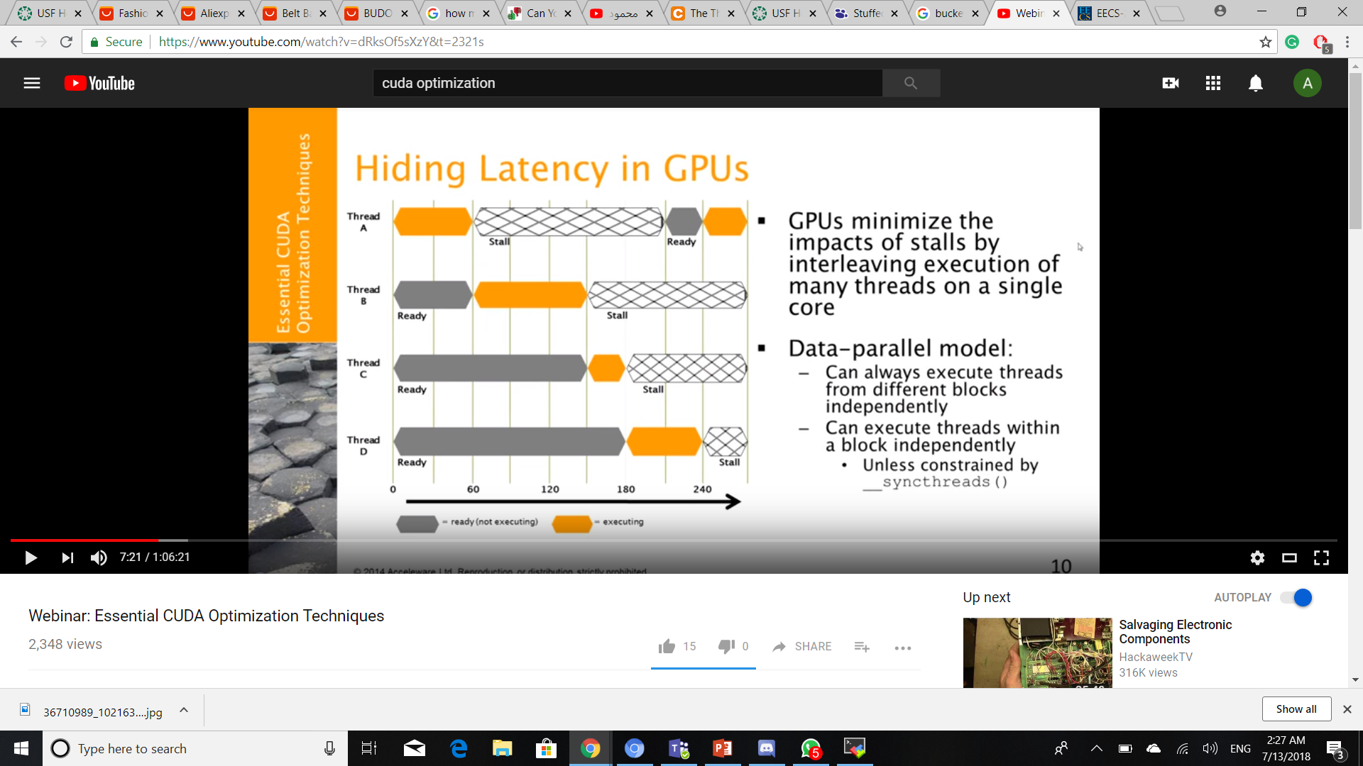
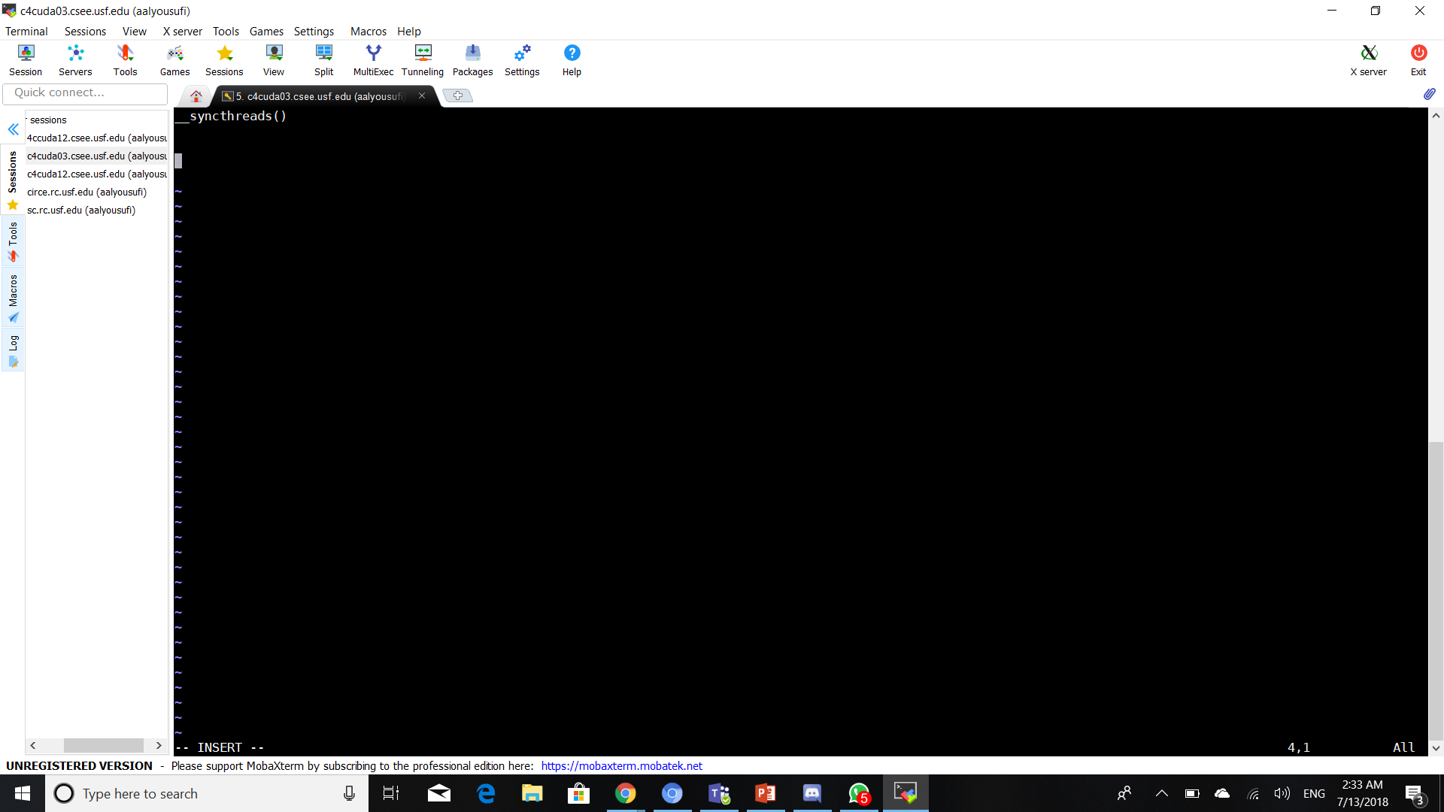
Hiding latency in gpu
GPUs:
Minimize the impacts of stalls
by interleaving execution of
many threads on a single core.
Data-parallel model:
Can always execute threads
from different blocks independently.
Can execute threads within a block
independently.
* unless constrained by

Slide 6
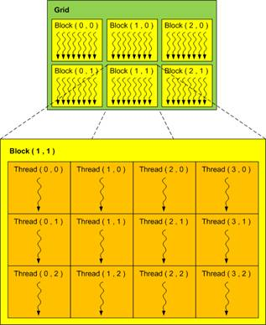
CUDA THREAD HIERARCHY
A kernel is executed over a thread
hierarchy:
i) Threads are grouped into
thread blocks
ii) Threads blocks are grouped
into a grid

Slide 7
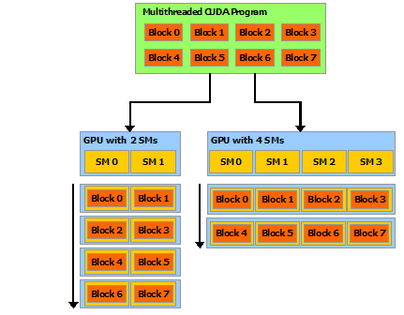
The cuda programming model
Blocks from the multithreaded/grid being distributed across streaming multiprocessor(SMs)
Each block will only execute one multiprocessor.
But, multiprocessor could execute multiple blocks.
Blocks must be independent

Slide 8
What is a warp?
The SM creates, schedules, manages and executes thread in the group of parallel threads called warps.
Individual threads composing a warp start together at the same program address but are otherwise free to branch and execute independently.
When a multiprocessor is given one or more thread blocks to execute, it splits them into warps that get scheduled by the SM.
Warp: a group of 32 threads that gets allocated or divided from the block.
Example: launching a block with 96 threads would be portioned to up to 3 warps of 32 threads each.

Slide 9
Resources allocation
When a block is scheduled to run on a multiprocessor, resources in that SM are allocated on an exclusive basis:
Shared memory-per block
Register-per block, with unique registers for each thread with the block.
This enables zero-overhead switching between warps at any point in their execution.

Slide 10
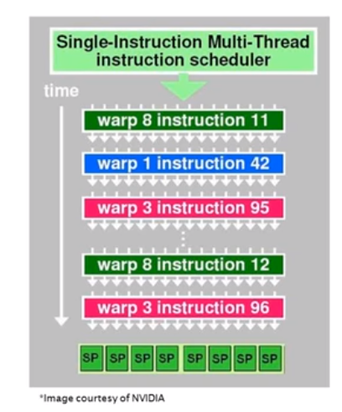
WARP execution
A scheduler on a SM evaluates all available warps to find on that is ready to execute an instruction
Eg. Not waiting on data from memory
The instruction is executed for the warp
The scheduler re-evaluates all available warps instruction
The effectively hides latency if:
There is a high ratio between arithmetic and memory operations/synchronization
OR there are enough warps to select from
Instructions for a warp are still executed in order!

Slide 11
occupancy
Occupancy= active warps / maximum active warps multiprocessor
Occupancy determined by:
Choice of block size
Kernel register usage
Shared memory usage
Hardware limitations
Limitations | Compute 2.x | Compute 3.x | Compute 5.0 | Compute 5.2
Max no. of thread/block | 1024 | 1024 | 1024 | 1024
Warp size(no. of threads) | 32 | 32 | 32 | 32
#Registers/SM (KB) | 32768 | 65536 | 65536 | 65536
Shared memory/SM (KB) | 16/48 | 16/32/48 | 64 | 96
Max no active blocks/SM | 8 | 16 | 32 | 32
Max no active warps/SM | 48 | 64 | 64 | 64
Max no. active threads/SM | 1536 | 2048 | 2048 | 2048

Slide 12
Occupancy and performance
Switching to other warps to mask latency is key to performance!
Need ‘enough’ other work to mask
May not need 100% occupancy!
Once you have reached the threshold, additional occupancy won’t improve performance.
‘Enough’ occupancy depends on the code
Memory bound kernels typically need more then compute bound
Often trading off resource usage for occupancy
May change algorithmic efficiency too!

Slide 13
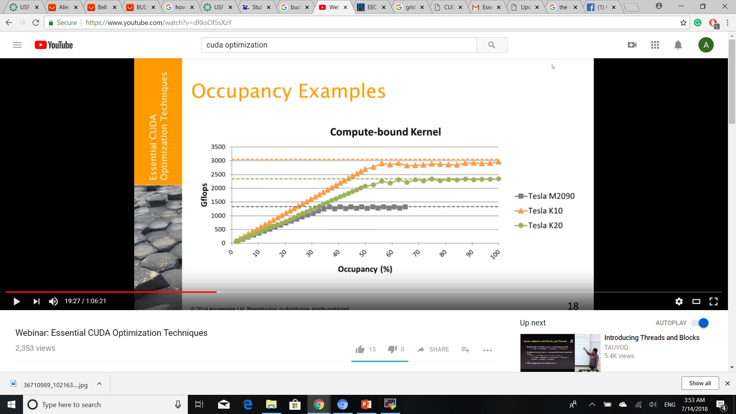
Occupancy examples

Slide 14
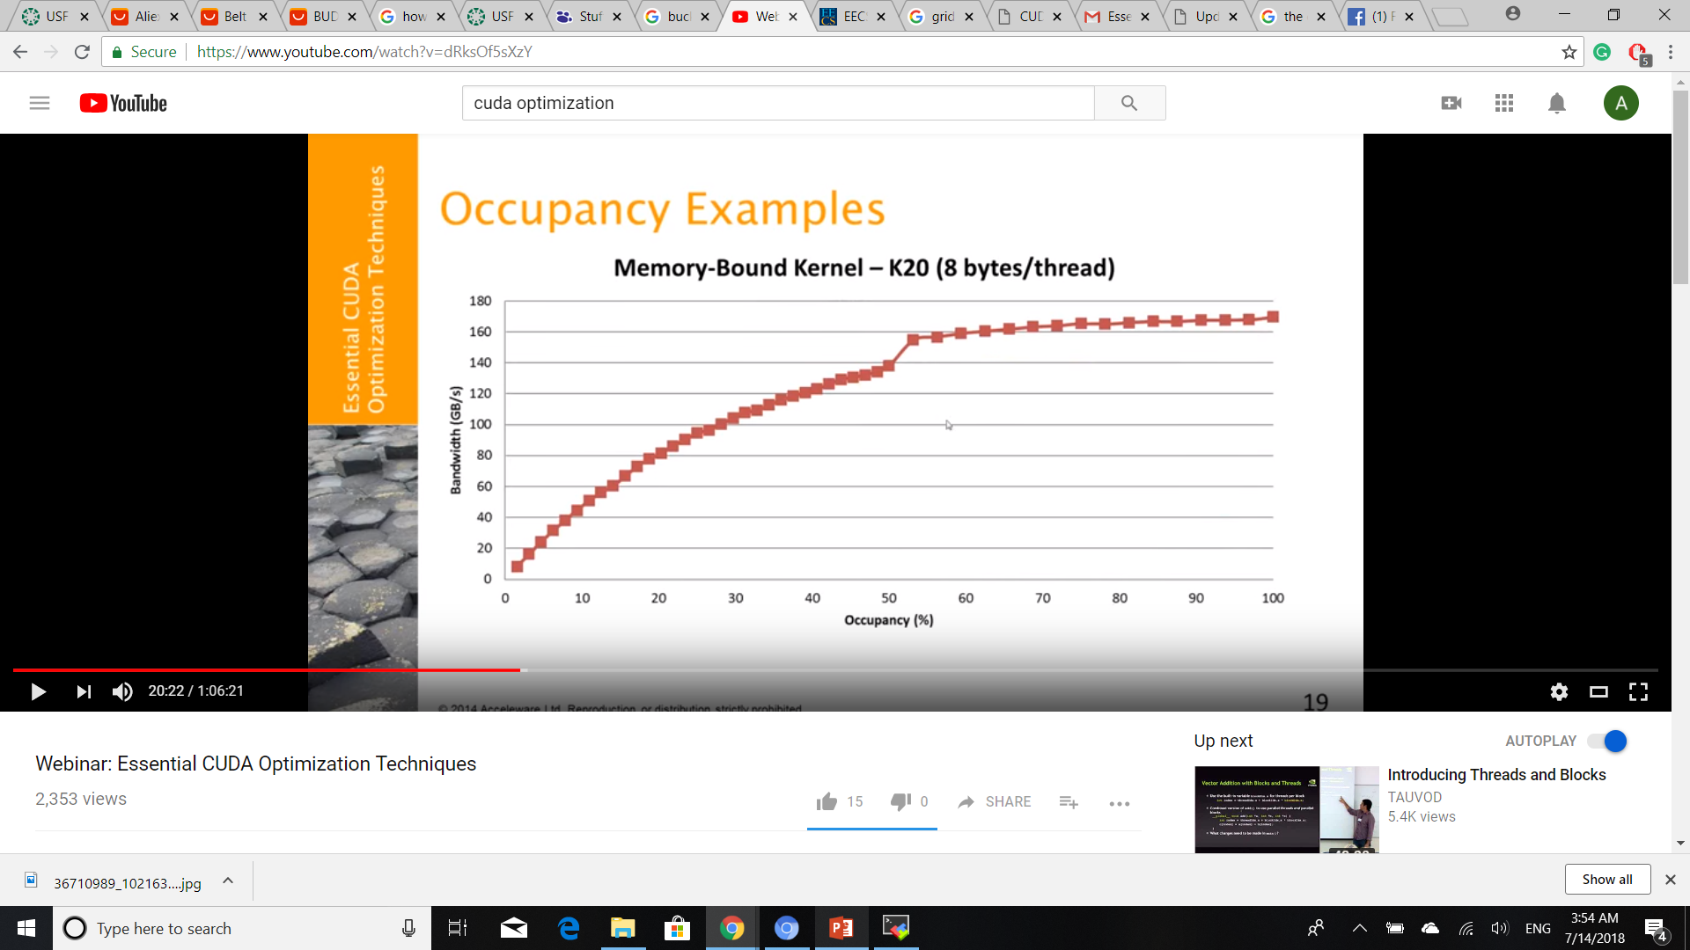
Occupancy examples

Slide 15
Optimizing latency bound kernels
Low theoretical occupancy
Adjust block size, register usage, shared memory usage.
Occupancy calculator can help!
Low achieved occupancy
Eg. Launching 32 blocks of a kernel that runs with 2 blocks/SM on a GPU with 16 SMs.
Theoretical occupancy is 100%
Achieved occupancy is approx. 50%
Consider concurrent kernel execution

Slide 16
Optimizations for compute bound kernels

Slide 17
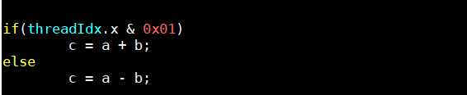
Efficiency and branching
GPU executes instruction for the entire warp.
Full efficiency is realized when all 32 threads of a warp agree on their execution path.
If thread of a warp diverge via a conditional branch, the warp serially executes each branch path
Only the active threads in the warp execute the instructions for a path. Threads from the warp on other paths are idle.
Hence, hardware is underutilized when this occurs
Branch divergence occurs only within a war!

Slide 18
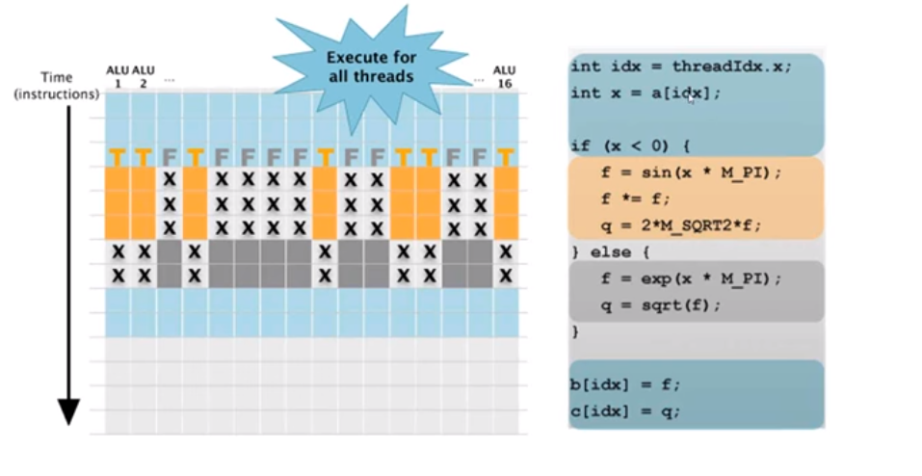
Efficiency and branching

Slide 19
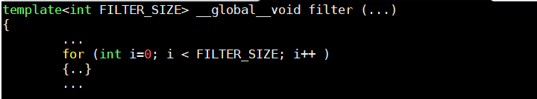
Iteration/loop unrolling (cont)
For small loop bodies reduce the loop overhead by unrolling
For known trip counts the compiler will unroll the loop
Ensure trip count is known at complete time by templating the kernel
Control unrolling with #pragma unroll
#pragma unroll 1 prevents unrolling
#pragma unroll N unrolls the loop N times
#pragma untoll unrolls the loop completely

Slide 20
‘Fast’ math
Consider intrinsic function
Approximate versions of many math library functions
Slightly reduced accuracy, higher throughput
__sinf() vs sinf()
Compiler flags
--use_fast_math : redirect all math functions to intrinsic
-prec-div=false
-prec-sqrt=false

Slide 21
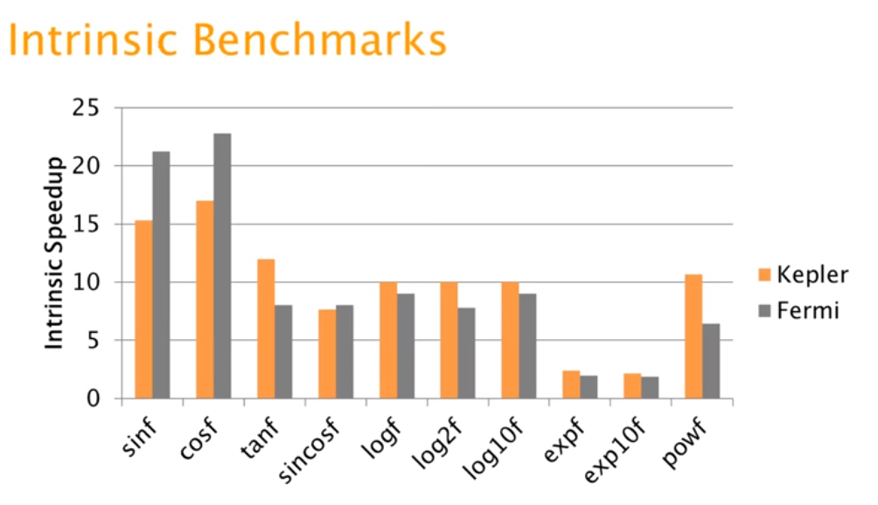
Intrinsic benchmarks

Slide 22
Shuffle instruction on Kepler
Allows threads within a warp to share data
Use this functionality instead of shared memory
A single shuffle instruction can replace shared memory write/sunc/read sequence
Any thread can read any other thread’s data within a warp
__shfl()
Support for useful patterns
__shfl_up()
__shfl_down()
__shfl_xor()

Slide 23
Optimizations for memory bound kernels

Slide 24
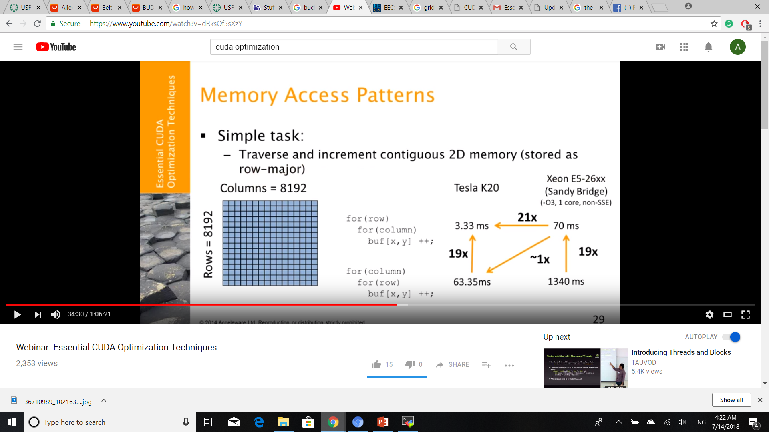
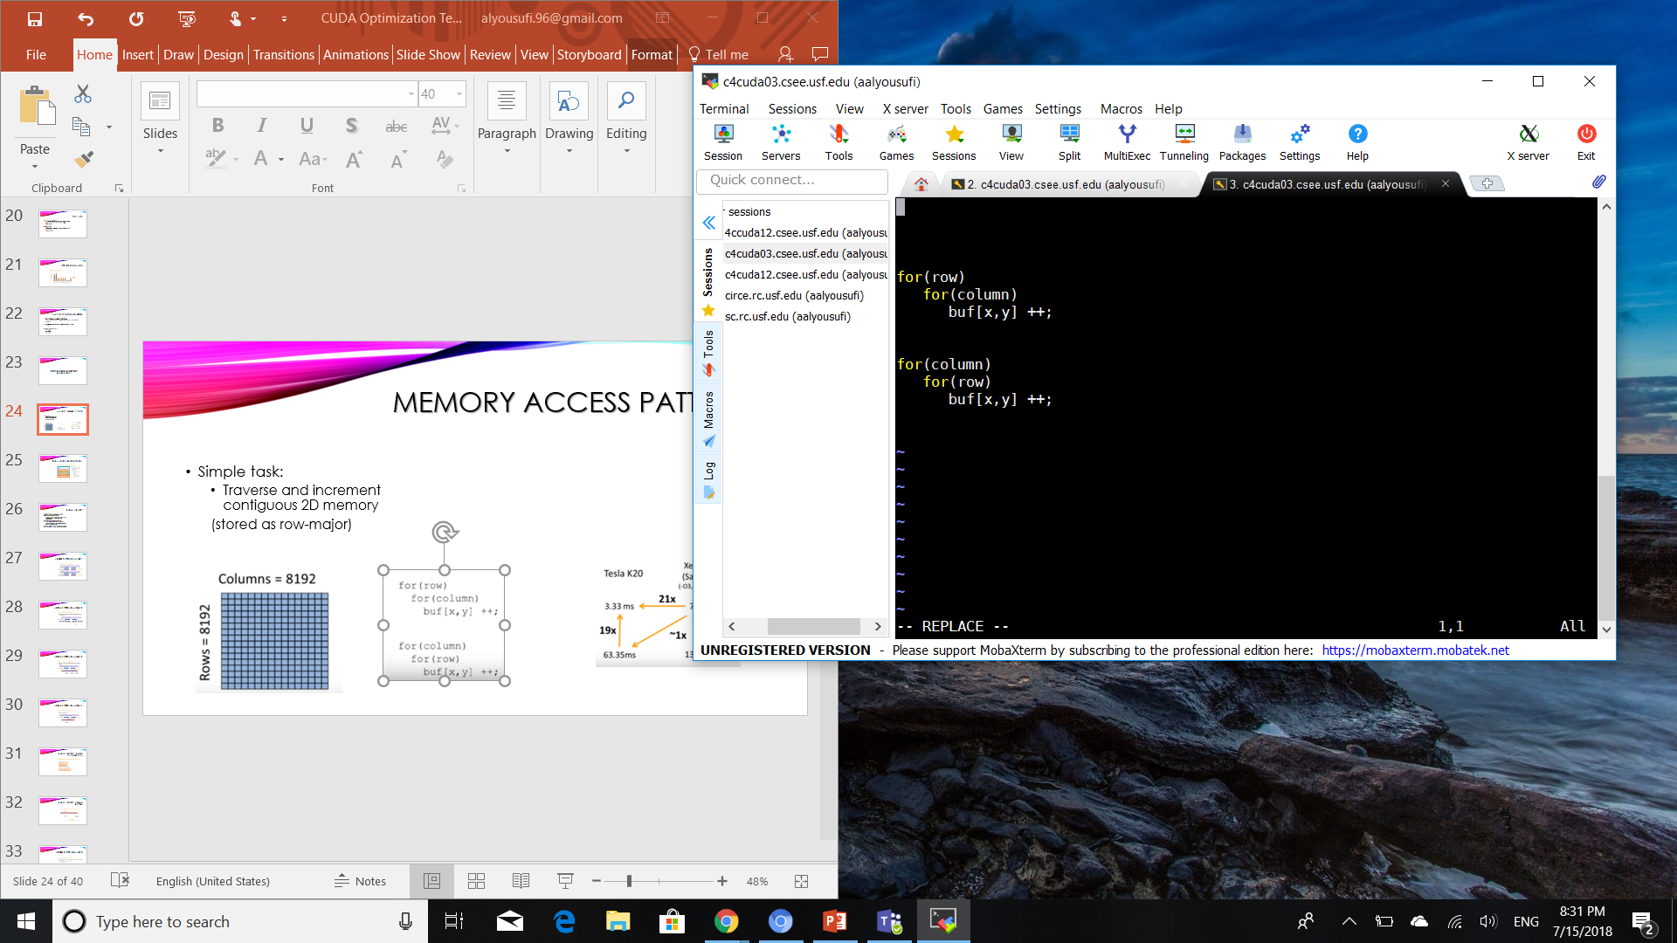
Memory access patterns
Simple task:
Traverse and increment contiguous 2D memory
(stored as row-major)

Slide 25
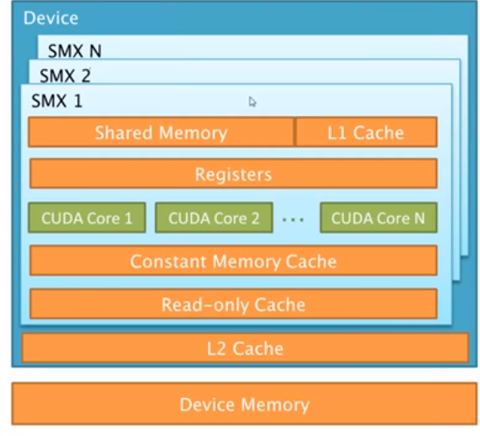
CUDA MEMORY SPACES (REVIEW)
Several memory “spaces”
Programmer-controlled hierarchy
Spaces vary by:
Size
Location(on/off chip)
Scope
Cached/non
Access(R/W)
Performance rules
Latency/thoughput

Slide 26
GLOBAL MEMORY
Global memory is most efficient when threads in a warp access an aligned contiguous region of memory
Individual thread requests can be combined (or coalesced) into fewer and larger transactions.
Can be quite inefficient otherwise
Minimum transaction size across the bus
For Kepler GPUs, minimum transaction size is a 32B aligned L2 cache line
Specifics depend on GPU architecture, word size (1,2,4,8 byte words), and access patterns

Slide 27
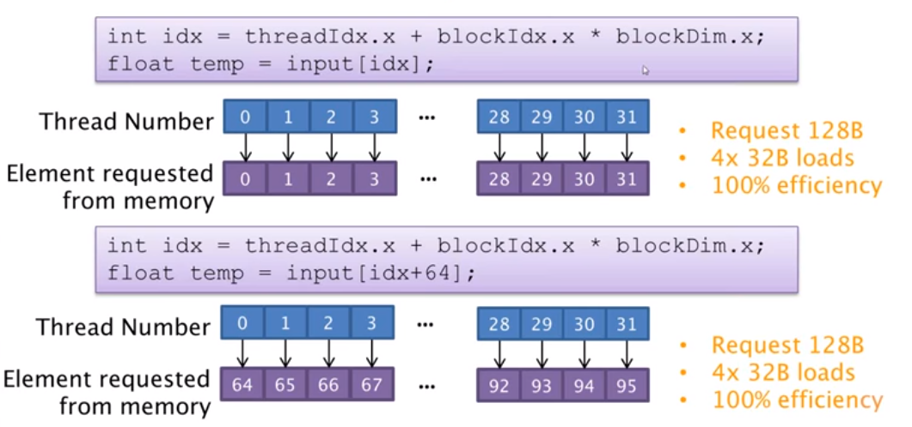
ACCESS PATTERN EXAMPLES(1)
Maximized the amount of memory that you are going to be able to bring it across the bus

Slide 28
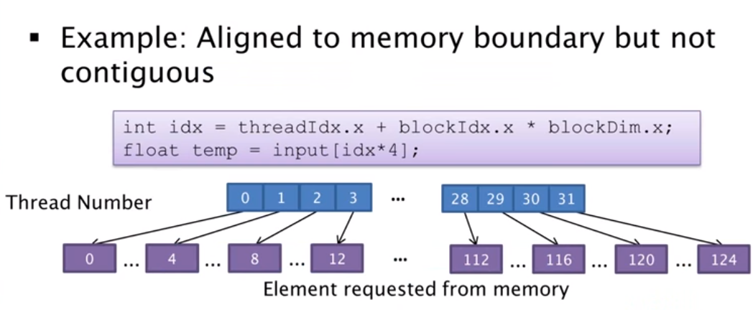
Access pattern examples (2)
Request 128B
16x32B loads
25% efficiency

Slide 29
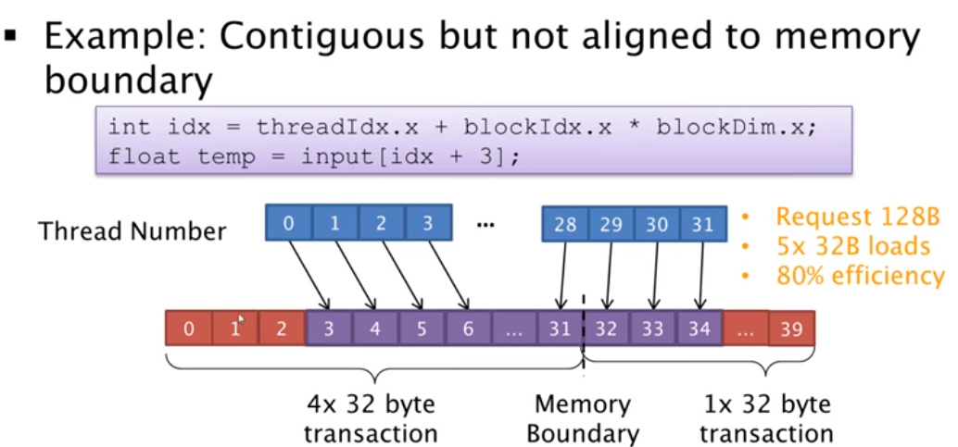
ACCESS PATTERN EXAMPLES (3)

Slide 30
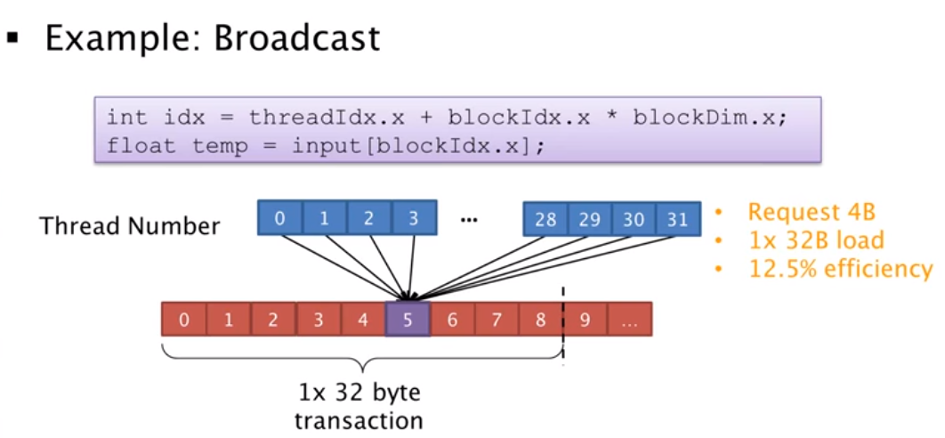
ACCESS PATTERN EXAMPLES (4)

Slide 31
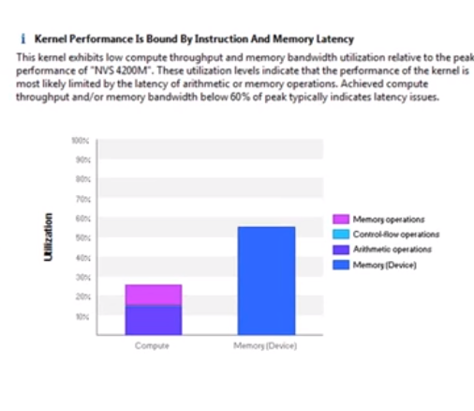
SUMMARY LATENCY LIMITED KERNELS
Low theoretical occupancy
Adjust block size, register usage, shared memory usage.
Occupancy calculator can help!
Low achieved occupancy
Consider concurrent kernel execution
Theoretical occupancy is 100%
Achieved occupancy is approx. 50%
Eg. Launching 32 blocks of a kernel that runs with 2 blocks/SM on a GPU with 16 SMs.

Slide 32
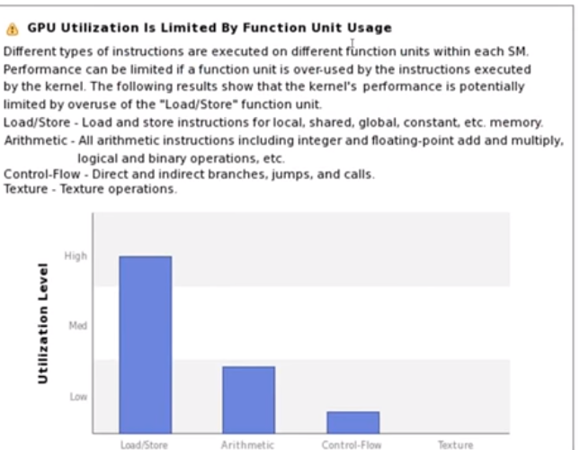
SUMMARY COMPUTE BOUND KERNELS
Branching/warp divergence
Loop unrolling
Fast math
Shuffle

Slide 33
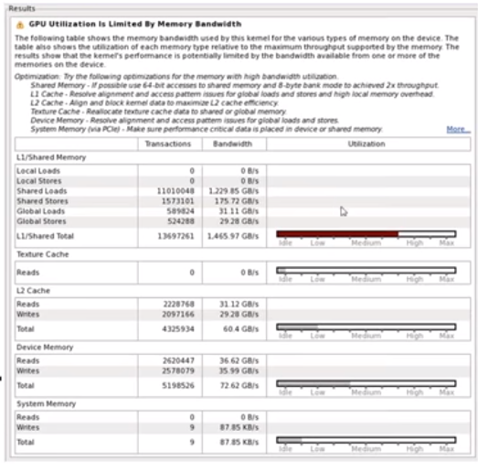
SUMMARY MEMORY BOUND KERNELS
Global Memory
Access patterns
Data structures
Shared Memory
Bank conflicts
64-bit accesses
Constant memory vs Read-only cache

Slide 34
Work cited
Paper`1: Extending parallelization of the self-organizing map by combining data and network partitioned methods by Richardson, Trevor & Winer, Eliot
Paper`2: Computation of gray-level co-occurrence matrix based on CUDA and its optimization by Hong, Huichao & Zheng, Lixin & Pan, Shuwan
Paper’3: A CUDA-Based Real Parameter Optimization Benchmark by Ding, Ke & Tan, Ying
Chapter 6 “PERFORMANCE CONSIDERATIONS” : Book: Programming Massively Parallel Processor By David & Wen-mei
Chapter 8 “APPLICATION CASE STUDY: ADVANCED MRI RECONSTRUCTION” : Book: Programming Massively Parallel Processor By David & Wen-mei
Chapter 12 “2 CONCLUSION AND FUTURE OUTLOOK” : Book: Programming Massively Parallel Processor By David & Wen-mei
Youtube: CUDA Part D: GPU Optimization Part 2; Peter Messmer (NVIDIA)

